Slide 1
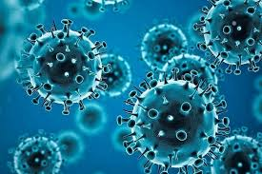
COVID-19 POSITIVE CASES, DEATH CASES AND VACCINATION ANALYSIS

Slide 2

Content:
Introduction
Data Overview
Exploratory Data Analysis
Covid-19 Data Over Time
Top countries with the highest new positive cases
Top countries with the highest death cases
Conclusions
Recommendations

Slide 3
Introduction
The goal of this analysis is to find out the trend of the virus over time and answer, which were the most affected countries by the number of positive cases, and the number of death cases and to gauge how effective the vaccination process was and if at all it played a part in slowing down the spread of the virus and number of death cases recorded across the globe.

Slide 4
Data Overview
For this project, I got 2 data sets from Kaggle, one called COVID-19 activity, which contained the daily number of cases, new cases recorded each day, and the daily number of death cases by continent, country, county, and province. https://www.kaggle.com/datasets/thedevastator/covid-19-global-case-and-death-data?select=COVID-19+Activity.csv
The second data set, COVID-19 vaccinations, contained the daily vaccinations done for each country across the globe. I first combined the 2 datasets to get an enriched dataset for analysis, and to reduce the volume of the data, I cumulated the daily records into monthly. This helped reduce the noise that came with the daily data records. COVID-19 World Vaccination Progress (kaggle.com)

Slide 5
Exploratory Data Analysis (EDA)
The Average Number Of People
With New Positive Covid-19 Cases was 11,632 Every Month
Stood at 44,385 cases from month to month
The Variability of New Positive Cases
From Covid-19 Infection was 42,770 across the world
The Average Number Of Deaths
Stood at 92,741 Cases from between months
The Variability of Death Cases
Notes:
These high standard deviations from the mean new positive cases and death cases between 2020 and 2021 showed just how unpredictable the virus was between the month as there were records of up to 92,741 death cases above the mean death cases around the world at least on of the months

Slide 6
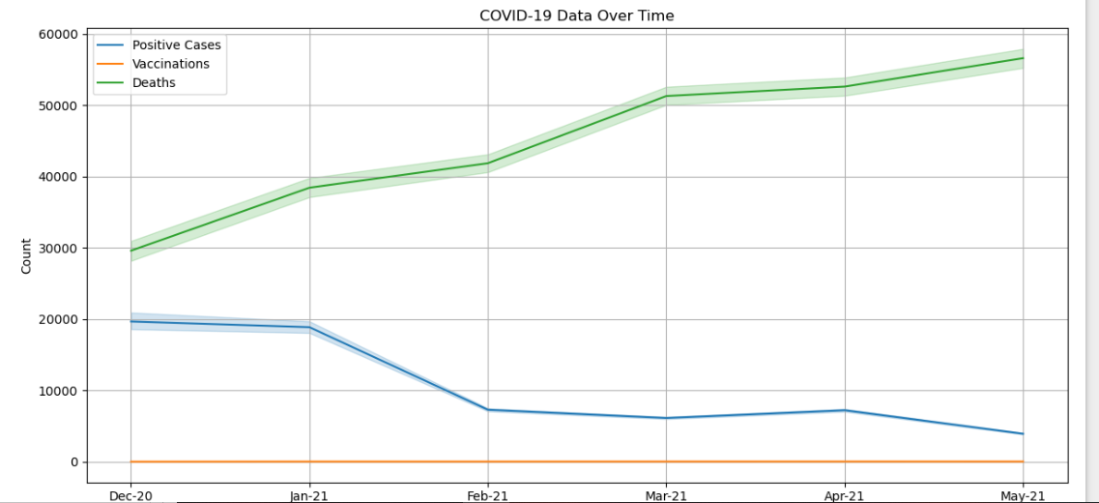
Covid-19 Data Over Time

Slide 7
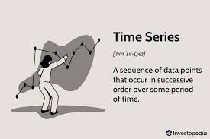
Covid-19 Data Over Time
This shows that while the number of new positive cases was going down with time with the introduction of vaccines, the number of death cases generally went up. Therefore the new positive cases might not be going down because of the introduction of vaccines, but rather because of the high death cases reducing the pull from the population that can be affected.
Notes:
The line chart also shows that although Covid-19 was a proven near fatal when one is infected, the vaccination process really lagged as only a handful of people were infected a whole year into the pandemics discovery.

Slide 8
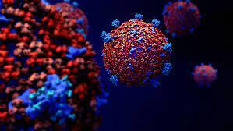

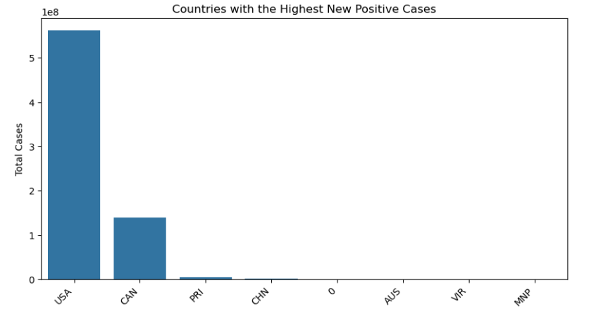
Countries With the Highest positive Cases
Notes:
The USA followed by Canada has the highest number of COVID-19 cases recorded over the analysis period with the rest of the countries in the world barely scratching the surface of infections over the period.

Slide 9


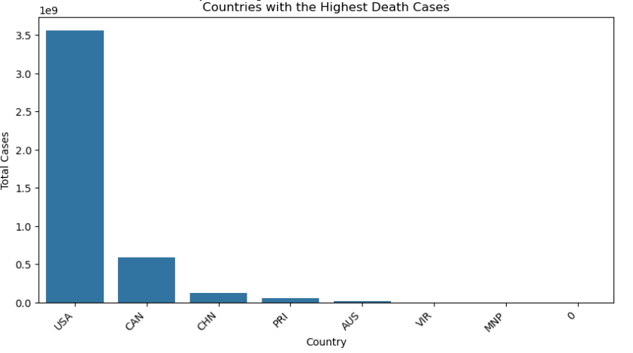
Top Countries With Highest Death Cases
Notes:
The USA, Canada, and China had the highest total death cases in total over the period. The high correlation between the 2 shows that the chances of one dying after being infected were very high

Slide 10
Conclusion
The Covid-19 pandemic took the world by surprise especially the USA, Canada, and China where it hit the hardest. This is evidenced by the large number of monthly increase in new positive cases and death cases particularly in those 3 countries.
If traveling from these countries to other countries is not limited, the latter months could see a surge in the number of cases, both new positives and deaths recorded in other countries

Slide 11
Recommendations
As per the analysis, it is evident that traveling from the USA, Canada, and China to other countries should either be restricted or stopped altogether to prevent the virus from spreading.
The countries' infected should also be placed in quarantine.
The rest of the countries with a small number of infected people should also place the necessary infrastructure in place as we can see that the number of infections can rise very fast from the standard deviations recorded.
The Vaccination Process should also really be stepped up as it is evident that a whole year and a half into the virus being declared a pandemic, only a handful of people have been vaccinated.

Slide 12


